Slide 1
LGD project
Team A

Slide 2
Introduction
To create a web-based management system for learning and development, providing dashboards for admins, managers, and employees to manage and track progress. Technologies Used:
Backend: Django
Frontend: HTML, CSS, JavaScript
Database: sqlLite

Slide 3
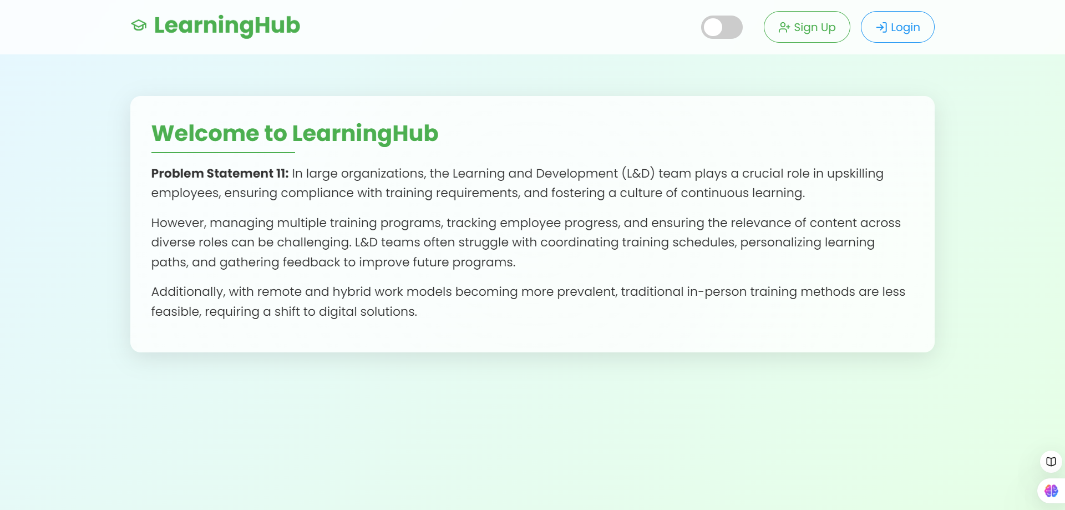
HOME PAGE

Slide 4
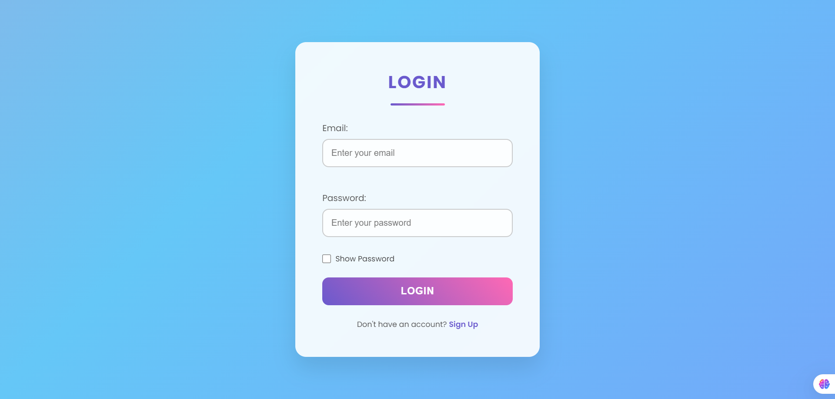
Login page

Slide 5
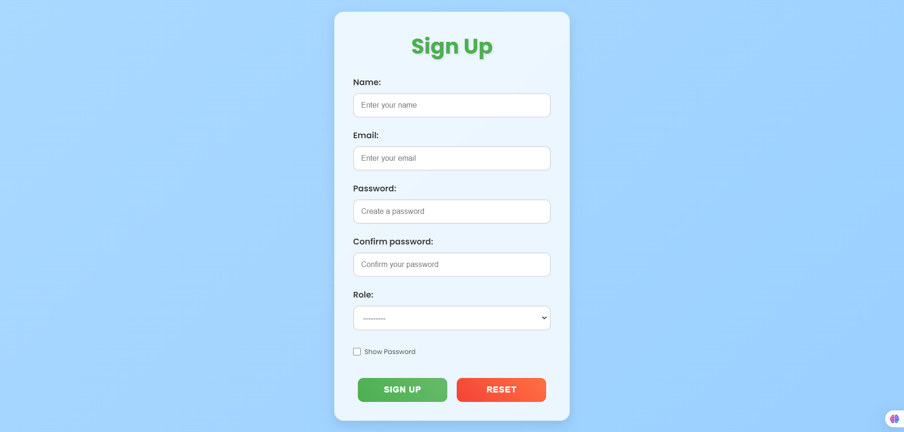
Signup page

Slide 6
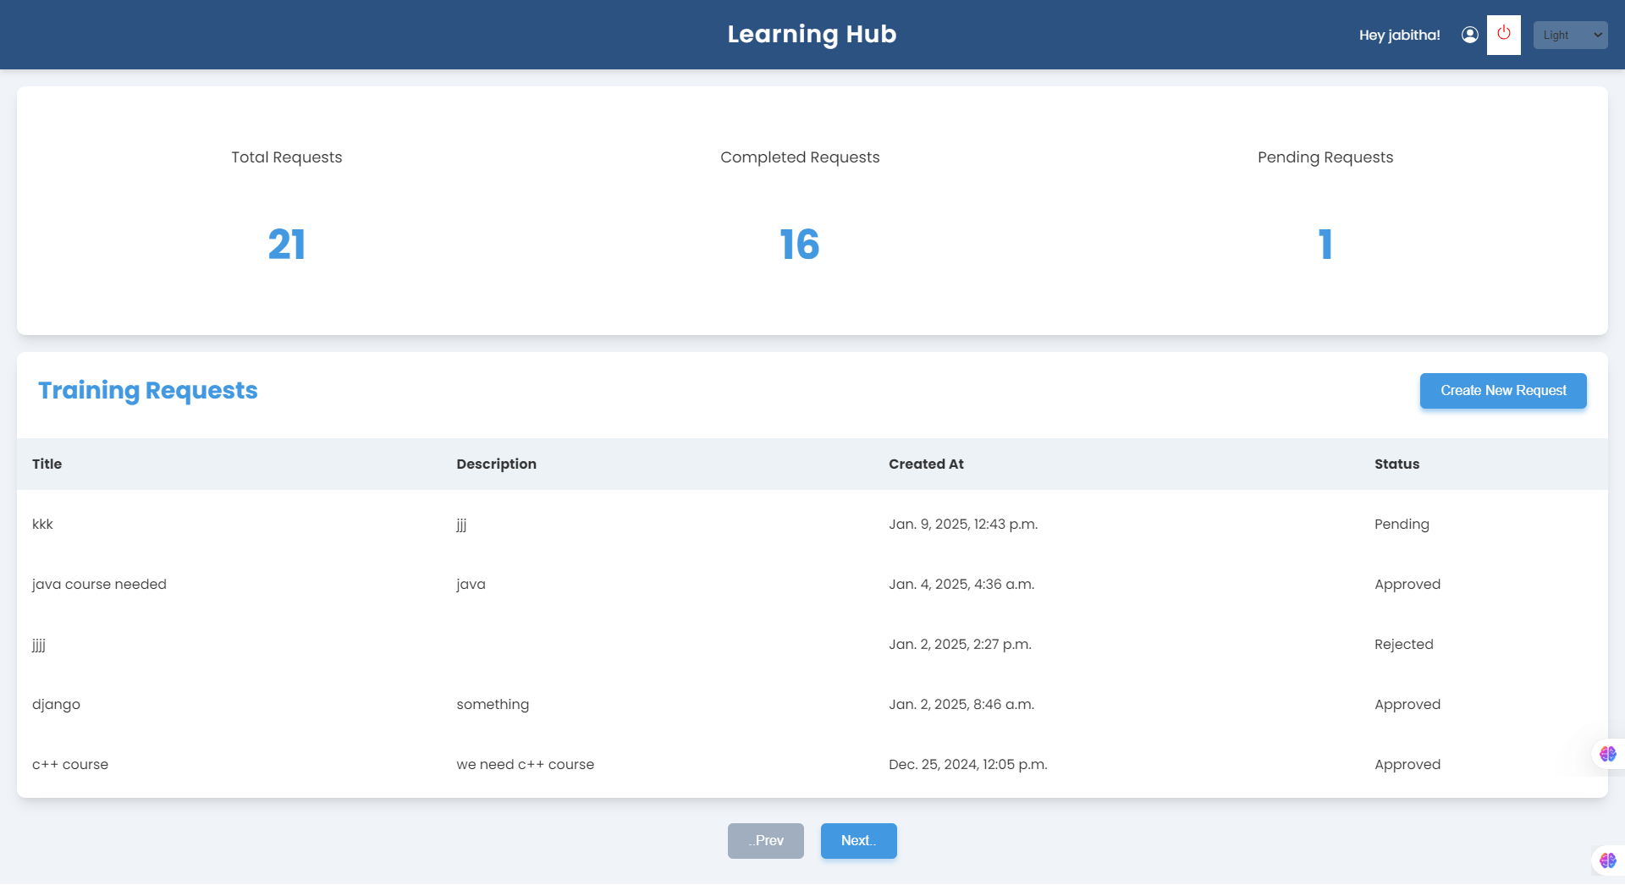
Manager page

Slide 7
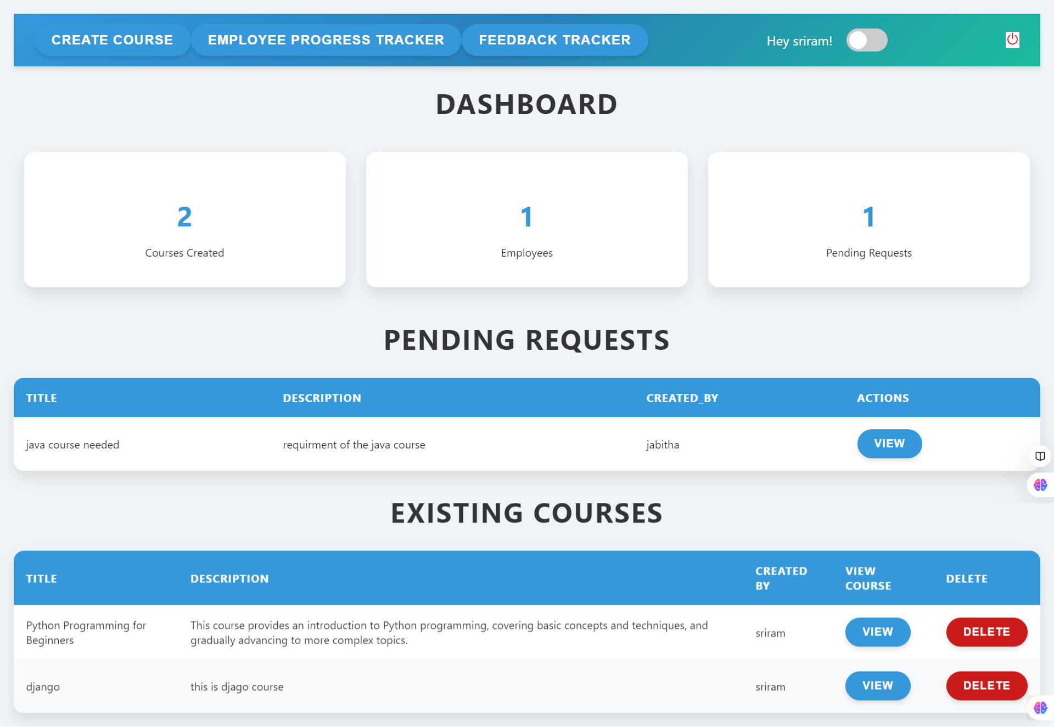
Admin page

Slide 8
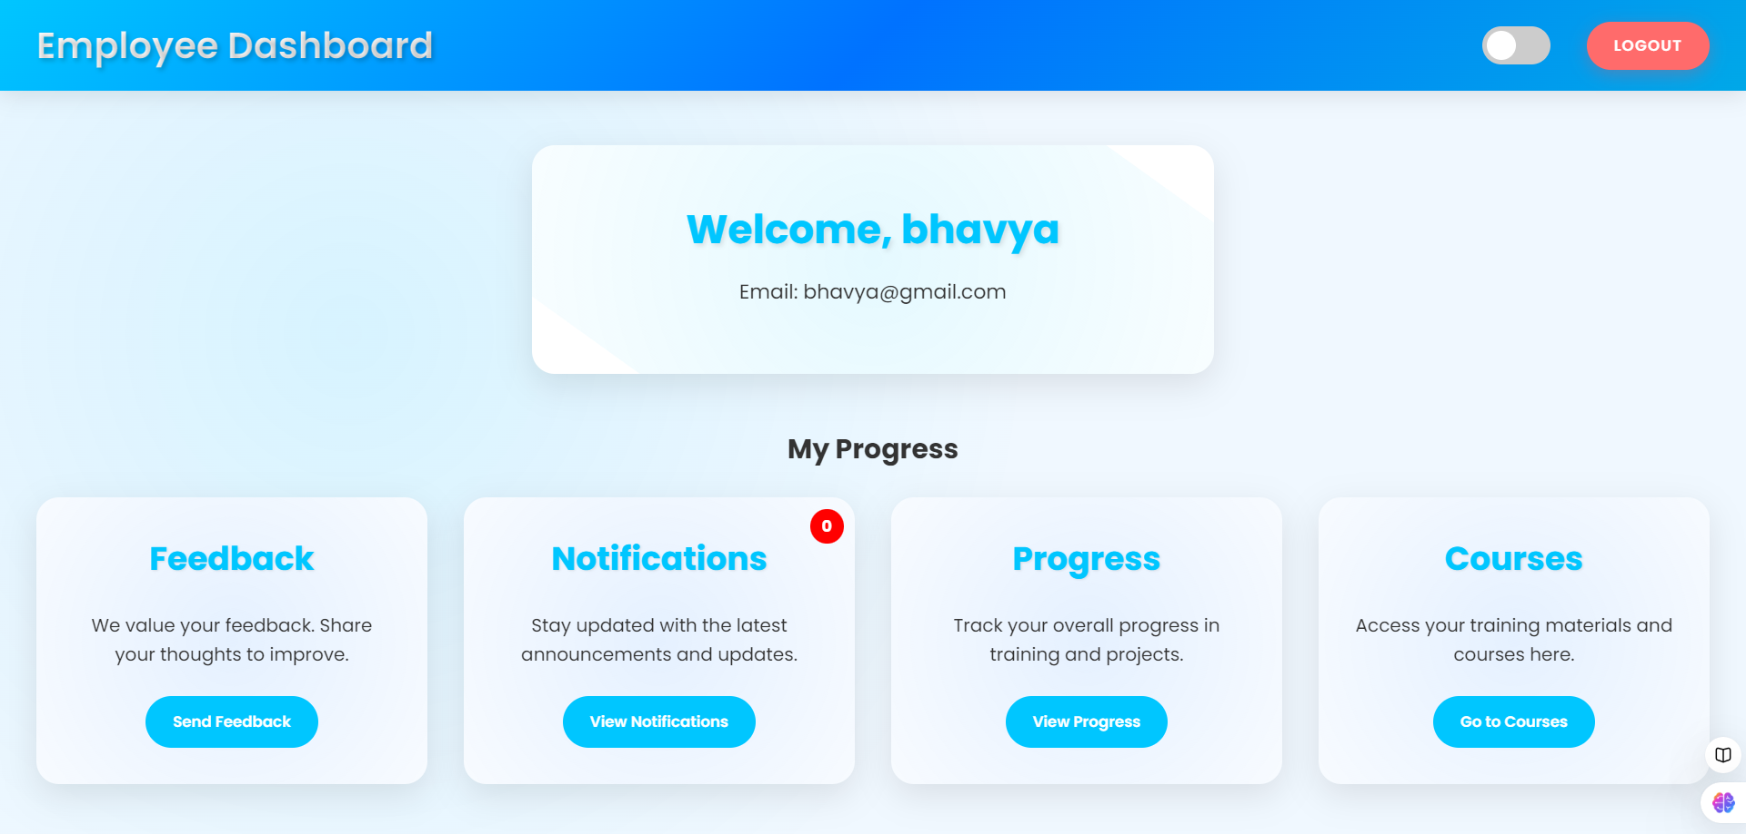

Slide 9
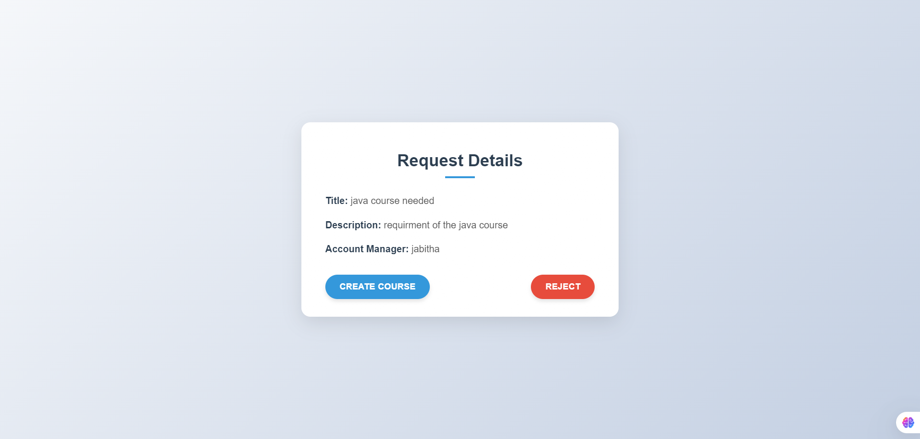
Admin action on training request

Slide 10
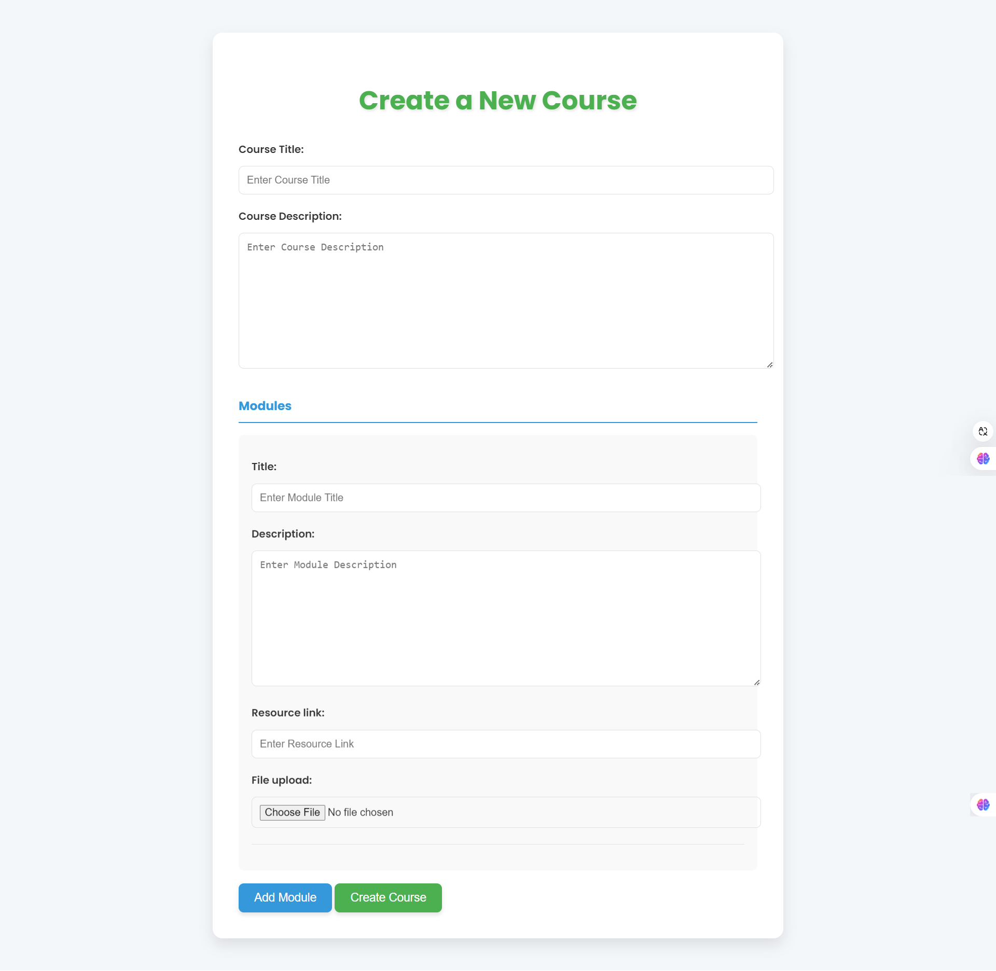

Slide 11
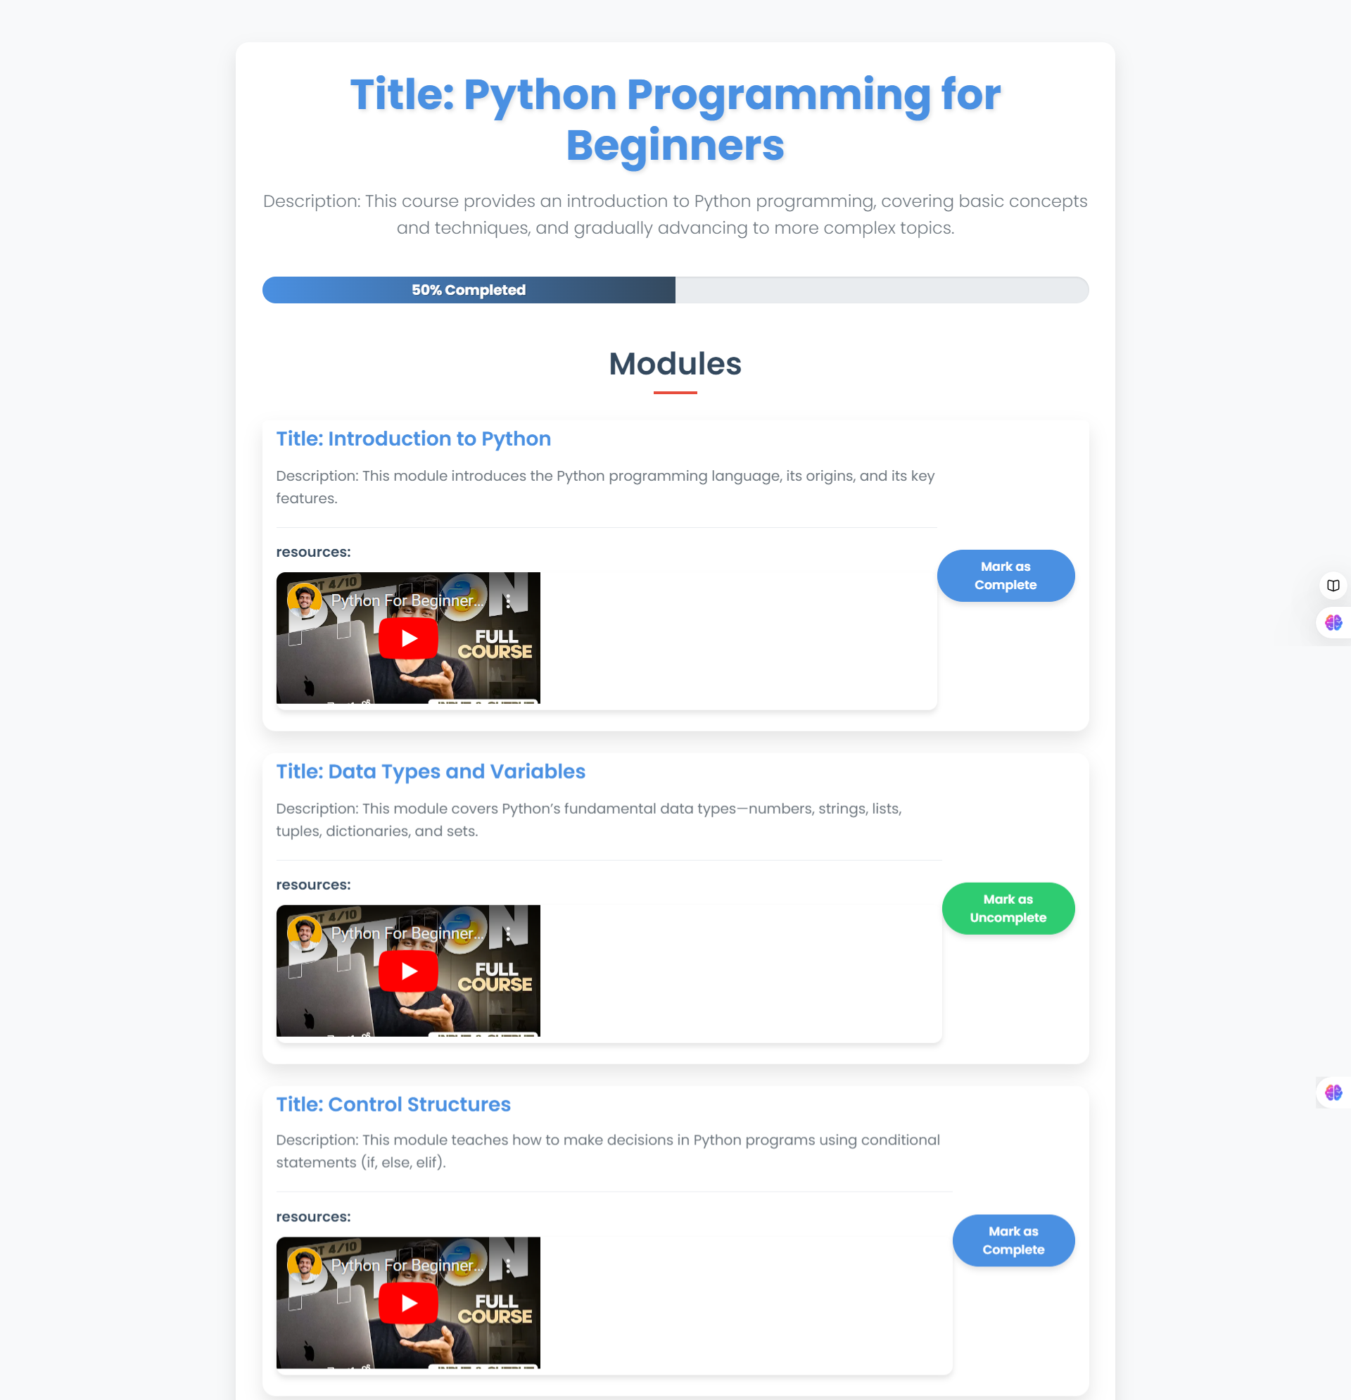

Slide 12
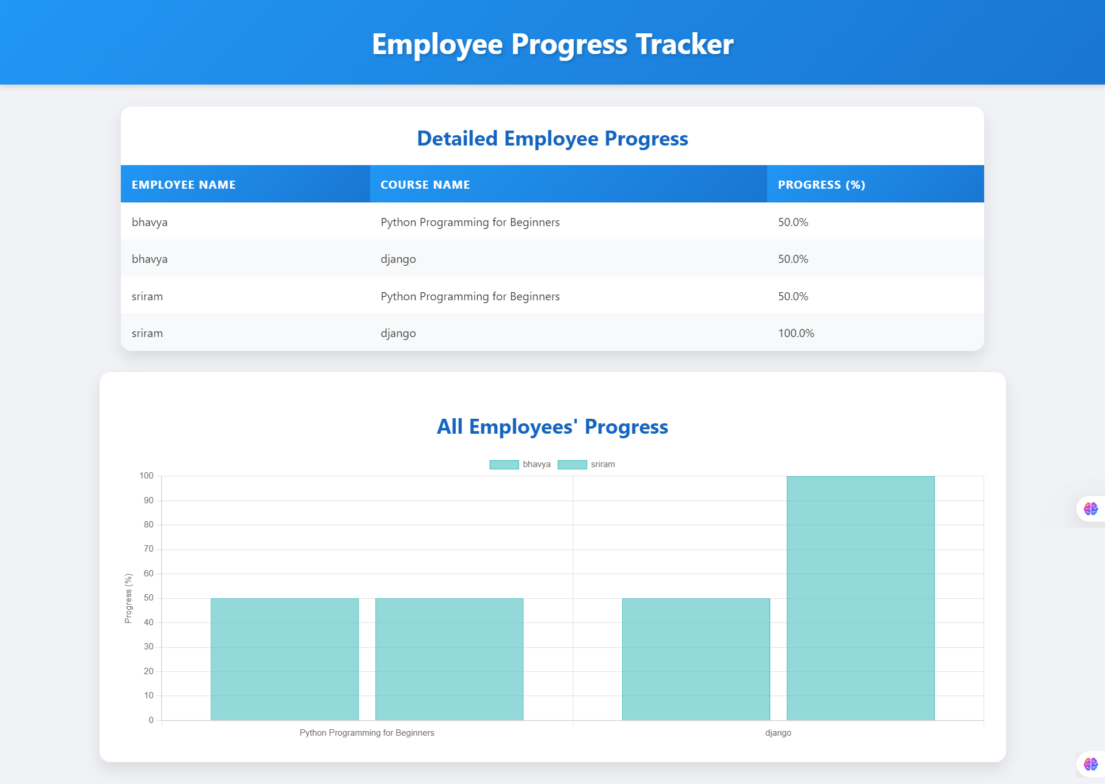

Slide 13
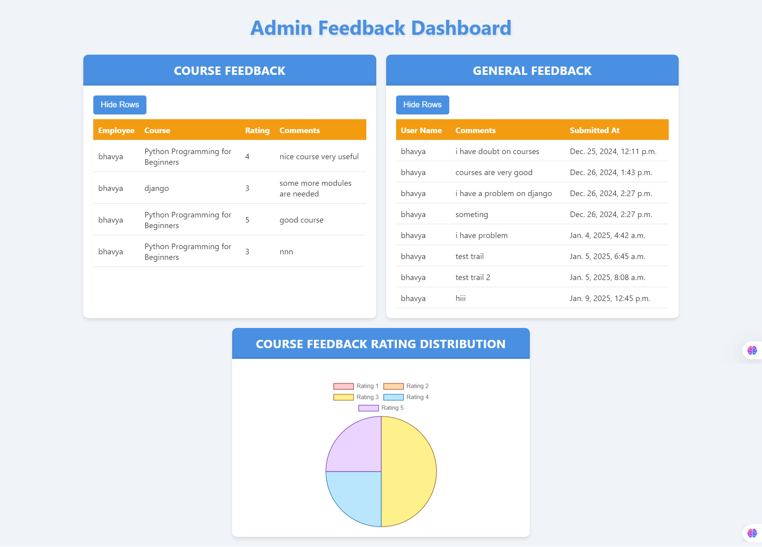

Slide 15
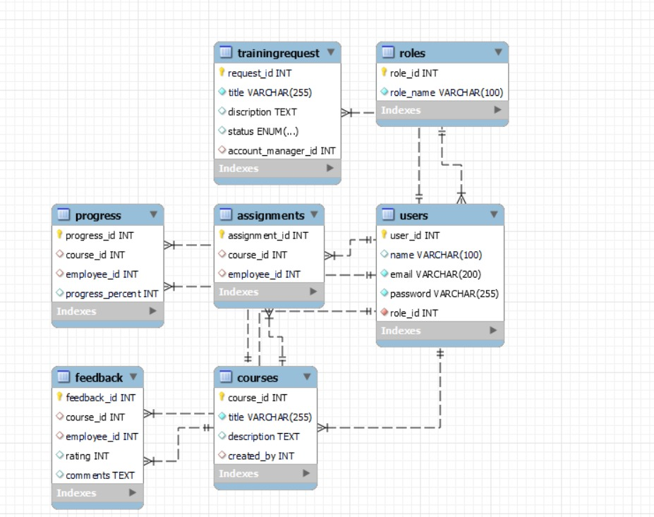
Database SCHEMA

Slide 16
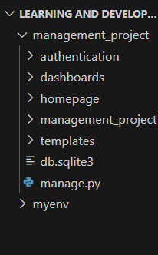
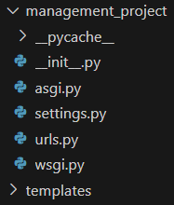
Backend file structure
Whole Project File Structure
Main Project file Structure

Slide 17
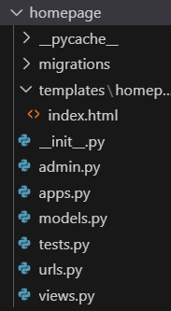
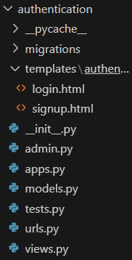
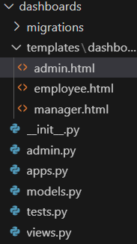
Django apps file structure
Homepage app
Authentication app
Dashboard app

Slide 18

Thank you

